Slide 1
GUIDELINES FOR INTERNSHIP PROGRAM FOR BACHELOR OF COMMERCE & BACHELOR OF BUSINESS ADMINISTRATION

Slide 2


Guidelines for 15-Days Internship Program for Bachelor of Commerce and Bachelor of Business Administration Students in colleges affiliated to Bangalore North University
Objectives:
To Provide practical exposure to students in the field of Commerce and Management.
To Bridge the gap between theoretical knowledge and practical application.
To Enhance students' understanding of real-world business operations.
To Develop students' professional skills and employability.

Slide 3
Program Structure
PRE-INTERNSHIP PHASE
Orientation Session: The college should conduct an orientation session to familiarize students with the internship program's objectives, guidelines, and expectations.
Industry Awareness Sessions: The college should organize sessions to create awareness about the Industries/Companies where students can intern.
Resume Building Workshops: The college should assist students in preparing resumes tailored to internship opportunities.
Internship Placement:The college should provide an Internship Request Letter (requesting the organisation to provide internship opportunity to the students) in the college letterhead signed by the Head of the Institution.

Slide 4
II. INTERNSHIP PHASE
Duration
The students of V semester B.Com and BBA after the completion of their 5th semester examination and before the commencement of 6th semester classes should undergo Internship training for Minimum 15 working days, with a minimum of 4 hours per day(Total 60 hours).
Area of Internship
The area of Internship can be in the fields of Commerce or Management. The choice of internship is in no way associated with choice of electives

Slide 5
Organisation
The choice of organization for Internship can be Organized or Unorganized sector, Manufacturing, Trading and Service sector, business enterprises and corporate establishments, like Micro, Small, Medium, and Large-Scale organizations, Sole Proprietary and Partnership firm, Government Organizations, Government departments and local bodies, Public and Private sector Banks, NGOs, Development agencies. Internships can be pursued in any location (anywhere in India or abroad).

Slide 6
Tasks and Responsibilities of Interns during Internship
Students have to collect various types of information and data from the company during their internship. Here are some common types of information and data that students may be expected to collect for preparing their report:
Company Overview: Background information about the company, including its history, mission, vision, and organizational structure.
Departmental Overview: An overview of the department or departments where the student worked, including their functions, roles, and responsibilities.
Internship Objectives: The objectives of the internship as outlined by the student and the company.
Tasks and Responsibilities: A detailed description of the tasks and responsibilities undertaken by the student during the internship.
Learnings and Experiences: Reflections on the learning experiences gained during the internship, including challenges faced and lessons learnt.

Slide 7
f ) Project Work: Details of any specific projects or assignments completed by the student during the internship, including the methodologies used and the results achieved.
g) Skills Development: Discussion of the skills developed or enhanced during the internship, such as communication, teamwork, and problem-solving skills.
h) Industry Analysis: Analysis of the industry in which the company operates, including trends, challenges, and opportunities.
i) Financial Analysis: Analysis of the company's financial performance, including profitability, liquidity, and solvency ratios.

Slide 8
j) Recommendations: Recommendations for the company based on the student's observations and experiences during the internship.
k) Conclusion: A conclusion summarizing the key findings and insights from the internship experience.
l) References: Any references or sources used in the report, such as books, articles, or websites. It's important for students to collect this information and data throughout their internship to ensure that they have enough material to create a comprehensive and insightful report. They should also maintain regular communication with their internship supervisor to seek feedback and guidance on the report.
5. Regular Check-ins: Ensure regular check-ins between the mentor and the student to monitor progress and address any issues. The mentors should maintain Internship Weekly Progress Template to record the progress of each student.

Slide 9
POST-INTERNSHIP PHASE
Certificate from the Organization
After completion of the internship, the student has to obtain a certificate from the company stating the period of the internship and a brief description of the nature of the internship i.e. responsibilities handled.
Submission of Internship Report
After completion of the Internship the students are required to submit an Internship Report along with the certificate from the organization, summarizing their internship experience, including the tasks performed, challenges faced, and learning outcomes. The report should be submitted within one month of commencement of 6th semester classes.

Slide 10
Format of the Report
The student has to submit 3 copies
Student copy
College copy
University copy of the report with minimum 25 pages and Maximum 40 pages each, soft bound Binding (without using any plastic sheets, PVC Sheets and Transparent sheets, using only eco-friendly material).
The report should be on A4 size paper printed on both sides, maintaining font type Times New Roman, font size of 12 for text, 12 bold for sub headings, 14 bold for headings. The document should have 1.5 line spacing, justified and with page numbering.

Slide 11
Chaptalisation
CHAPTER I: INTRODUCTION
CHAPTER II: DESCRIPTION OF THE ORGANISATION
CHAPTER III: EXPERIENTIAL LEARNING
CHAPTER IV: INTERNSHIP OUTCOMES AND CONCLUSION

Slide 12
5. Presentation:
Organize a presentation session where students can share their experiences and learnings with their peers and faculty.
6. Feedback:
Collect feedback from both students and organizations to evaluate the effectiveness of the internship program.

Slide 13
EVALUATION
Submission of Internship Report
After the successful submission of the report by students, concerned mentors should collect the report and preserve it in the college for evaluation by the external examiner
Preparation for Evaluation
The colleges through the mentors should create batches for evaluation in the college by external examiner. The batches should be created in UUCMS Portal as per university guidelines

Slide 14
Evaluation Marks
The internship Report will be evaluated for 30 marks and the Internship Viva Voce exam will be conducted for 20 marks
External Examiner: The Chairman BOE for B,Com and BBA will respectively allot the External Examiners from the panel of examiners to each college for the conduct of Internship Report Evaluation and Internship Viva Voce examination as per the batches created by the colleges in UUCMS portal.
The marks scored by the students will be entered by the external examiner in the UUCMS portal on the day of exam. And will be submitted to the university.
Each Examiner has to conduct Internship Report Evaluation and Internship Viva Voce examination for 20 students per day. The Remuneration to the examiners will be paid by the university as per the existing rules.

Slide 15
FORMAT OF INTERNSHIP REPORT
COVER PAGE
CERTIFICATE ISSUED BY THE COMPANY
COLLEGE CERTIFICATE
STUDENT DECLARATION
ACKNOWLEDGEMENT
TABLE OF CONTENTS
EXECUTIVE SUMMARY
CHAPTER I: INTRODUCTION

Slide 16
FORMAT OF INTERNSHIP REPORT
9. CHAPTER II: DESCRIPTION OF THE ORGANIZATION
10. CHAPTER III: EXPERIENTIAL LEARNING
11. CHAPTER IV: INTERNSHIP OUTCOMES AND CONCLUSION
12. BIBLIOGRAPHY
13. ANNEXURES
14. INTERNSHIP WEEKLY PROGRESS TEMPLATE
15. FORMAT OF INTERNSHIP APPLICATION /REQUEST LETTER

Slide 17
Cover Page
Internship Report on
A Study on Stores Management
at Maruthi Suzuki, Kolar Branch
Submitted in Partial Fulfilment of the Requirements of
Bachelor Of Commerce Degree of Bengaluru North University
BY Mr./Ms………….
REG NO - UUCMS ID
UNDER THE GUIDANCE OF Dr/Ms/Mr.............
Associate Professor of Commerce
NEW HORIZON COLLEGE ,MARATHAHALLI
GOVERNMENT FIRST GRADE COLLEGE KOLAR 2023-2024

Slide 18
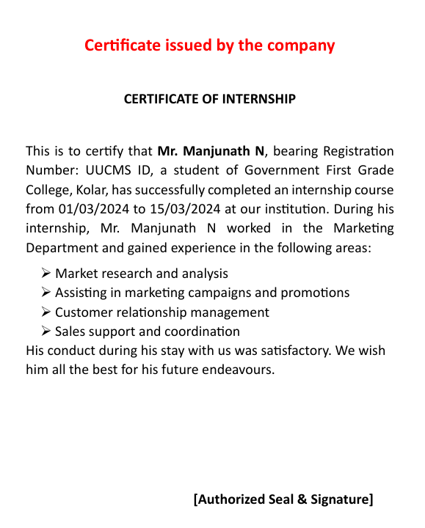

Slide 19
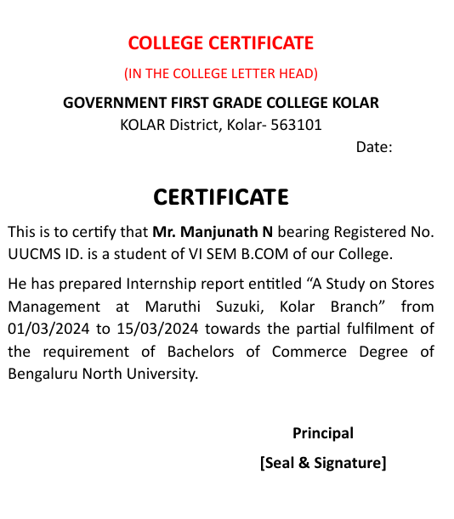

Slide 20
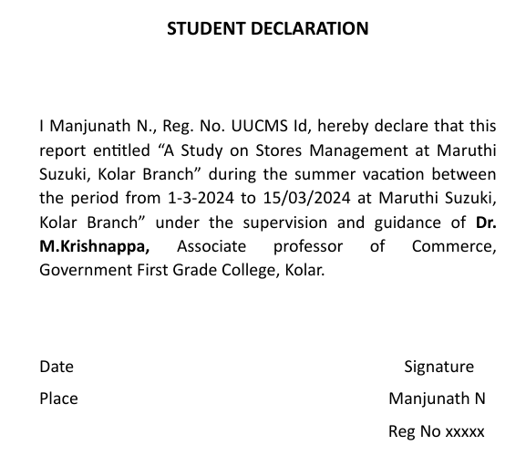

Slide 21
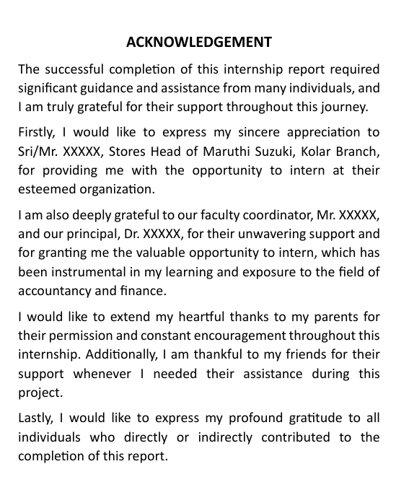

Slide 22
Table of Contents
Executive Summary
Introduction
Description of the Organization
Experiential Learning
Internship Outcomes and Conclusion
Bibliography
Annexures

Slide 23
Executive Summary
The executive summary provides a brief overview of the internship report, highlighting the key findings, outcomes, and conclusions of the study on the topic. (one page)
CHAPTER I: Introduction This chapter introduces the topic of the report, provides background information on about the topic, and outlines the objectives and scope of the study. (5-8 pages)
CHAPTER II: Description of the Organization This chapter provides a detailed description of the organisation, including its history, vision, mission, organizational structure, and the products and services it offers. (8-12 pages)

Slide 24
CHAPTER III:
Experiential Learning This chapter describes the intern's experience while working in the organisation, including the tasks undertaken, skills acquired, challenges faced, and lessons learned. (6-10 pages)
CHAPTER IV: Internship Outcomes and Conclusion This chapter presents the outcomes of the internship, including the findings related to the topic. It also includes a conclusion summarizing the key points of the report and suggesting recommendations for improvement. (6-10 pages)
Bibliography This section lists all the sources referenced in the report, like Books, Articles, Brochures, Catalogues, Websites etc Annexures This section includes any supplementary materials, such as interview transcripts, survey questionnaires, or additional data, that support the findings of the report.

Slide 25
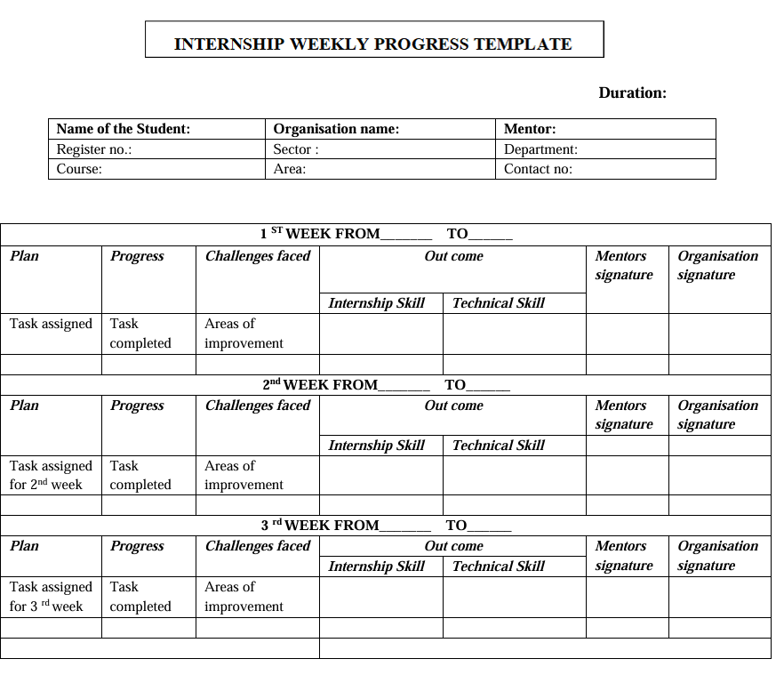

Slide 26
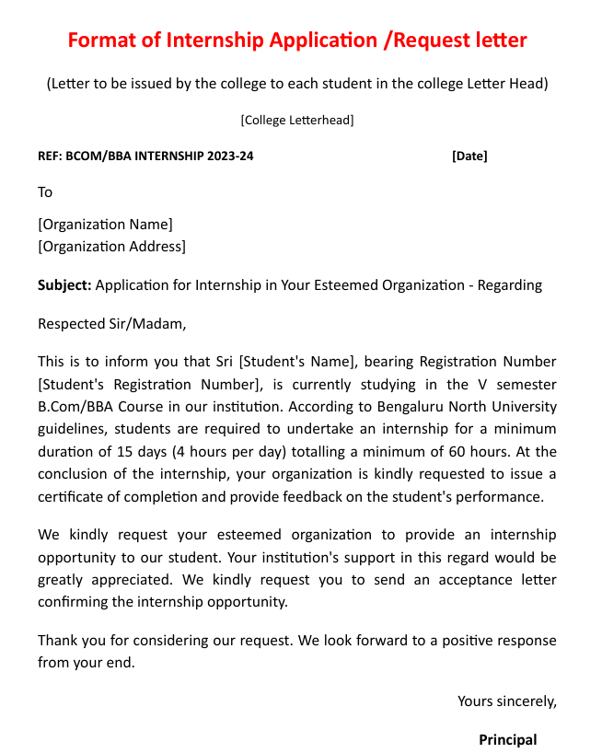

Slide 27
THANK YOU

